Slide 1
Flexbox
2025.2

Slide 2
Sumário
O que é flexbox?
Flexbox Properties

Slide 3
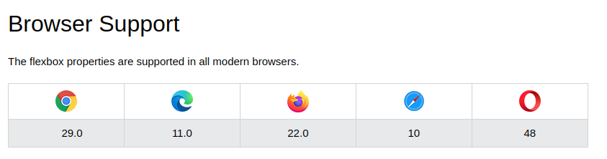
Introdução
Antes: Float e Positions
Antigamente: Float -> Alguns Problemas!
Flexbox: Extremamente simples
2017: W3C candidate (https://css-tricks.com/snippets/css/a-guide-to-flexbox/)
“The main idea behind the flex layout is to give the container the ability to alter its items” (CSS-TRICKS, 2022)
Fonte: W3SCHOOLS, 2022

Slide 4
Flexbox
A ferramenta Flexbox (de Flexible Box) foi criada para tornar essas tarefas mais simples e funcionais: os filhos de um elemento com Flexbox podem se posicionar em qualquer direção e pode ter dimensões flexíveis para se adaptar.
https://www.alura.com.br/artigos/css-guia-do-flexbox

Slide 5
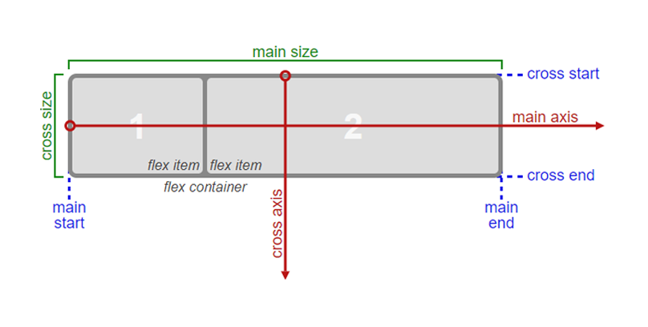
Flexbox
https://chiefofdesign.com.br/css-flexbox/

Slide 6
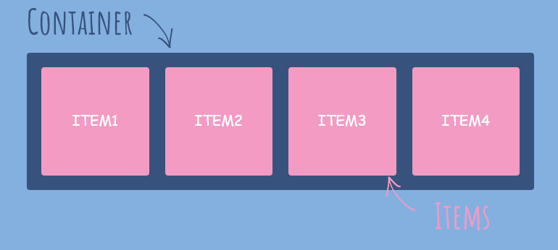
Introdução
Fonte: https://sharkcoder.com/files/article/flex1.png

Slide 7
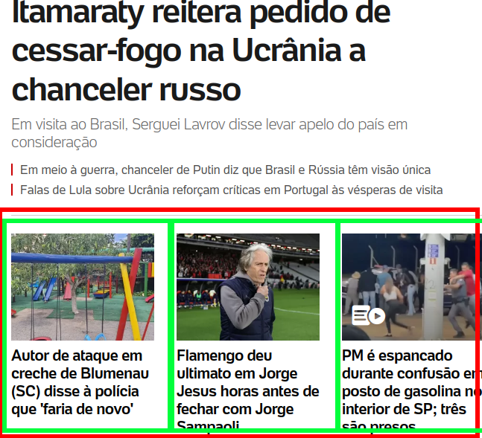
Introdução
Site: uol.com.br

Slide 8
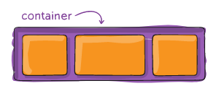
Flexbox Properties (flex container)
https://css-tricks.com/snippets/css/a-guide-to-flexbox/

Slide 9
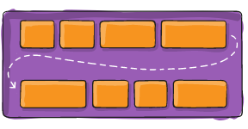
Flex-Container -> flex-wrap
WRAP
NOWRAP (default)
WRAP-REVERSE
https://css-tricks.com/snippets/css/a-guide-to-flexbox/

Slide 10
Flex-Container -> flex-wrap
CODE
.flex {
display: flex;
}
.item {
background-color: blue;
width: 20%;
margin: 10px;
}
<div class="flex">
<div class="item">Item 1</div>
<div class="item">Item 2</div>
<div class="item">Item 2</div>
</div>

Slide 11
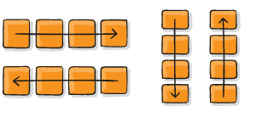
Flex-Container -> flex-direction
row (default) | row-reverse
cloumn | column-reverse
https://css-tricks.com/snippets/css/a-guide-to-flexbox/

Slide 12
Flex-Container -> flex-direction
CODE
.flex {
display: flex;
flex-direction: column;
}

Slide 13
Flex-Container -> flex-flow (Atalho)
Flex-direction + flex-wrap
row nowrap; row wrap
https://css-tricks.com/snippets/css/a-guide-to-flexbox/

Slide 14
Flex-Container -> flex-flow (Atalho)
Flex-direction + flex-wrap
row nowrap; row wrap
.flex {
display: flex;
/* flex-wrap: wrap;
flex-direction: column; */
flex-flow: column wrap;
}

Slide 15

Flex-Container -> justify-content (main axis)
https://css-tricks.com/snippets/css/a-guide-to-flexbox/

Slide 16
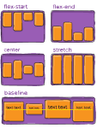
Flex-Container -> align-items - (cross axis)
https://css-tricks.com/snippets/css/a-guide-to-flexbox/

Slide 17
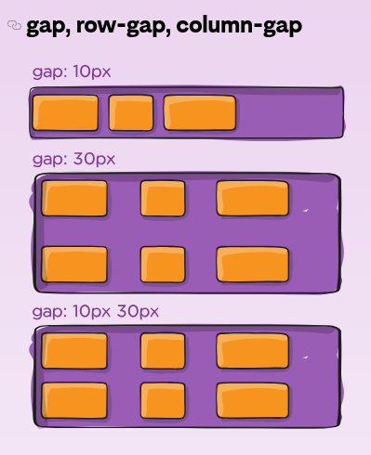
Gap
https://css-tricks.com/snippets/css/a-guide-to-flexbox/

Slide 18
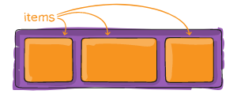
Flexbox Properties (flex-items)
https://css-tricks.com/snippets/css/a-guide-to-flexbox/

Slide 19
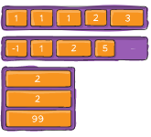
Flexbox Properties (order)
https://css-tricks.com/snippets/css/a-guide-to-flexbox/

Slide 20
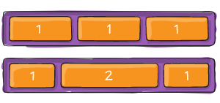
Flexbox Properties (align-self)
Exemplo column
https://css-tricks.com/snippets/css/a-guide-to-flexbox/

Slide 21
Flexbox Properties (align-self)
.filho-2 {
order: 1;
align-self: flex-end;
}
Exemplo column

Slide 22
Exercício#3
https://flexboxfroggy.com/
Zerar! Enviar foto do resultado final no teams :)
Termine o jogo e envie uma print no teams!

